Slide 1
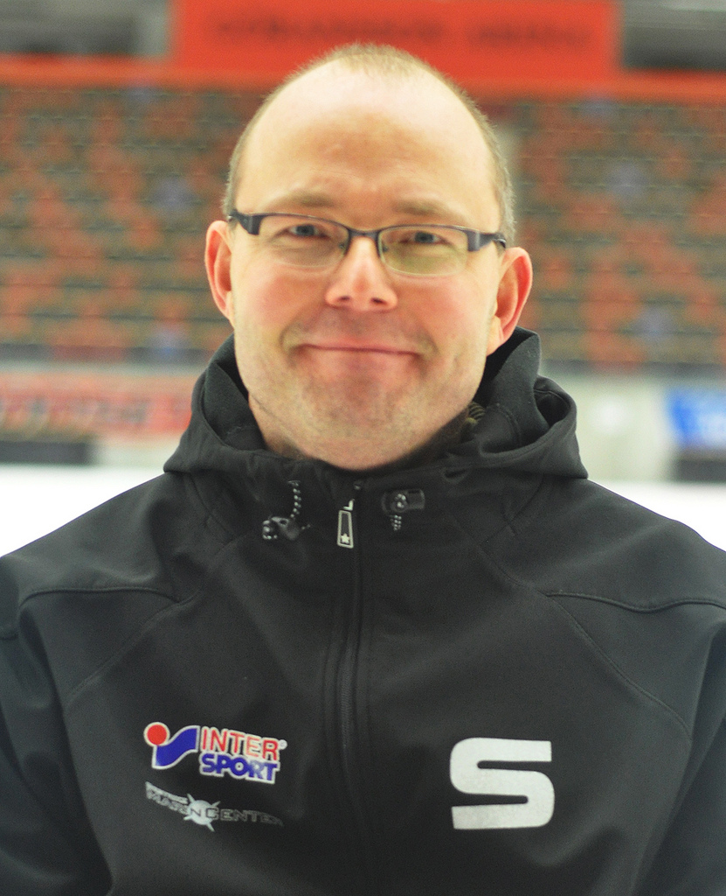
Jukka (42)
Senior engineer at corporateorg.com
Nationality: Finnish
Jukka is married with children and lives in a detached house in Pirkkala, Finland. Jukka has a Volvo V50 D2 and he buys a new car every 3 years.
His preferred operating system is Windows. He has a Thinkpad laptop and a Lumia phone.
Jukka does not want to learn new programming languages and is not following the latest R&D or programming trends.
“I like having a decent IDE that manages all of the sticky details for me.”

Slide 2
Motivation
Jukka’s biggest motivation is earning a living to be able to support his family.
Challenges
Work-life balance: since he is working in a large, multinational company, he has telcos and online meetings in the evenings because of having colleagues and partners across time zones.
Appreciates
Jukka appreciates having a secure position in a stable, large and multinational company.
Fears
Organizations changes in his company that result in downsizing workforce.
Avoids risks both at work and in personal life.
Hobbies
Jukka’s family has a summer cottage and he likes to spend as much time as possible there especially during the summer. He likes to build and renovate and enjoys barbecuing.
Jukka trains for a marathon, but he also enjoys good food and beer. He owns shares in a micro-brewery.
APINF considerations
Jukka wants stability and simplicity:
Used to having good tool support, but does not necessarily get to choose the tools freely because of company IT policy
Following best practices
Solid and clear API documentation easily available
Code examples in his preferred programming language, e.g. Java or C#
”Contract” for all the aspects of the API
Not willing or able to adopt new things or trends
SDK

Slide 3
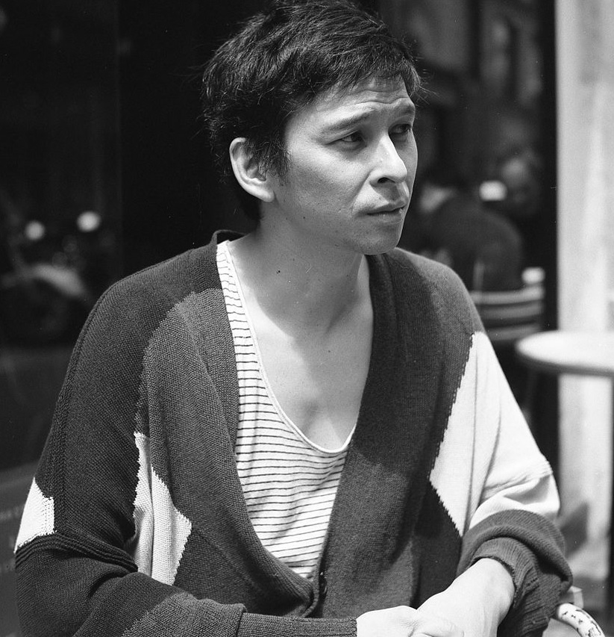
Minh (24)
(Junior) mobile application developer in a start-up
Nationality: Vietnamese.
Minh is single. He lives in Kallio in a sub-level single-room apartment.
Minh’s preferred OS is OSX, so he own a Mac. On the other hand, he has a Nexus phone.
“I don’t want to chew up too much battery just to parse big response.”

Slide 4
Motivation
Minh is ambitious: he wants to be able to prove himself and wants quick success.
Challenges
Minh is result-driven and passionate about his work. He doesn’t separate work and spare time, which may lead to exhaustion.
Company instability and lack of resources.
Appreciates
New trends and being productive fast.
Hobbies
He plays badminton and drives a fixed-speed bicycle.
Sometimes he works in a café drinking his caffè latte. It’s easy for him to concentrate even when there there is background noise and something happening all the time and he feels that the presence of other people makes him more creative.
APINF considerations
Devices Minh is developing for have limited HW and SW resources
  Memory
  CPU
  Library-features
  Connection
Simple and dynamic solutions: no time to learn complex APIs or complex tools
Uses standard language libraries and does not like ”language bindings”
Preferred languages: Python, Ruby, Scala, JavaScript
Basic HTTP and JSON
Agile

Slide 5
Sources and licensing
Sources for pictures:
https://www.flickr.com/photos/saikbandy/11220058205/
http://commons.wikimedia.org/wiki/File:Eric_Minh_Cuong_Castaing.jpeg
Personas partially based on:
User personas for HTTP API’s
https://www.mnot.net/blog/2012/04/14/user_personas_for_http_apis
This work is licensed under a Creative Commons Attribution-NonCommercial-ShareAlike 4.0 International License.

